Slide 1

Memory Error Detection in Security Testing
Nasif Imtiaz, Laurie Williams
North Carolina State University
RunSafe Security

Slide 2
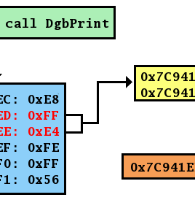
Memory errors are prevalent: during and after security testing

Slide 3
Research Questions
How frequently do memory-related alerts get identified by a security tool? How do developers respond to these alerts?
What portion of CVEs are memory related? How many of these CVEs were identified by the studied security tool when the involved flaws were first introduced in the code?

Slide 4
Data Sources
Extension of Coverity dataset from our prior work
Imtiaz, Nasif, Brendan Murphy, and Laurie Williams. "How Do Developers Act on Static Analysis Alerts? An Empirical Study of Coverity Usage." 2019 IEEE 30th International Symposium on Software Reliability Engineering (ISSRE). IEEE, 2019.
CVE dataset from NVD
Collected patch commits for Linux CVEs
Collected available exploit scripts

Slide 5
Coverity Dataset
Coverity scan reports for ten C/C++ projects from past years with scan interval less than a week
We can identify when an alert was first detected and when it was eliminated
We track back to commits made on the affected files to determine if developers made any code change to fix an alert (i.e. actionable)
We also have developer feedback from Coverity data if alerts were marked as Bug, Intentional, or False Positive
We calculated lifespan and fix complexity for the actionable alerts

Slide 6
Projects with historical Coverity scan reports

Slide 7
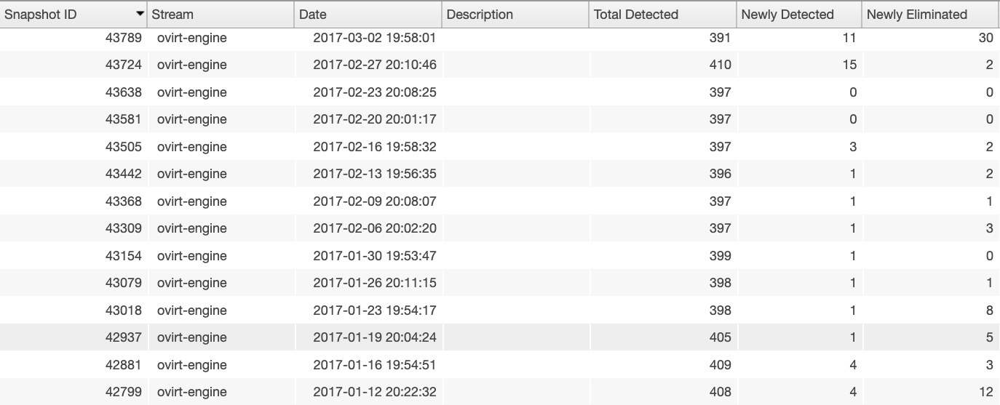
Analysis history on Coverity database

Slide 8
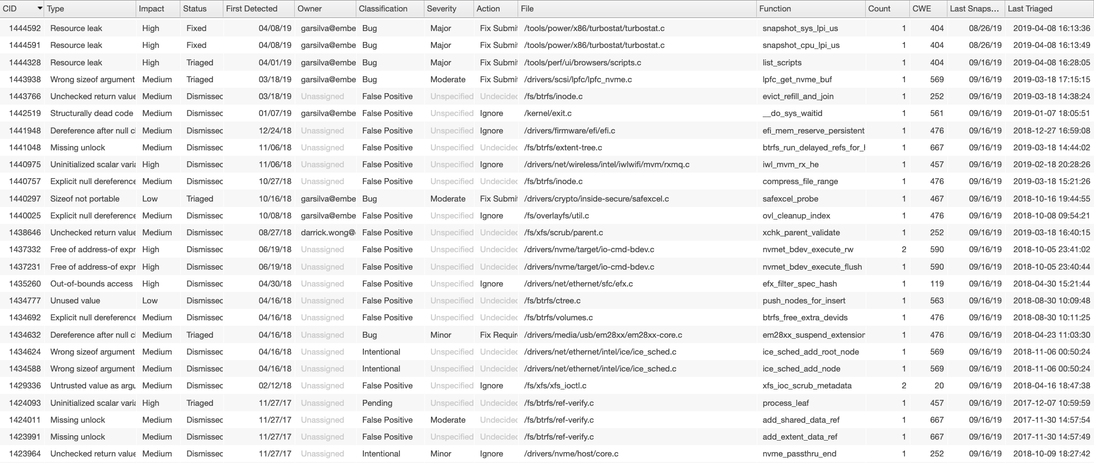
Alert history on Coverity database
Unique alert id, alert type, severity, status (fixed/dismissed/new), date when first detected, a classification given by the developers (e.g. bug/false positive or unclassified by default), file location, date when last detected

Slide 9
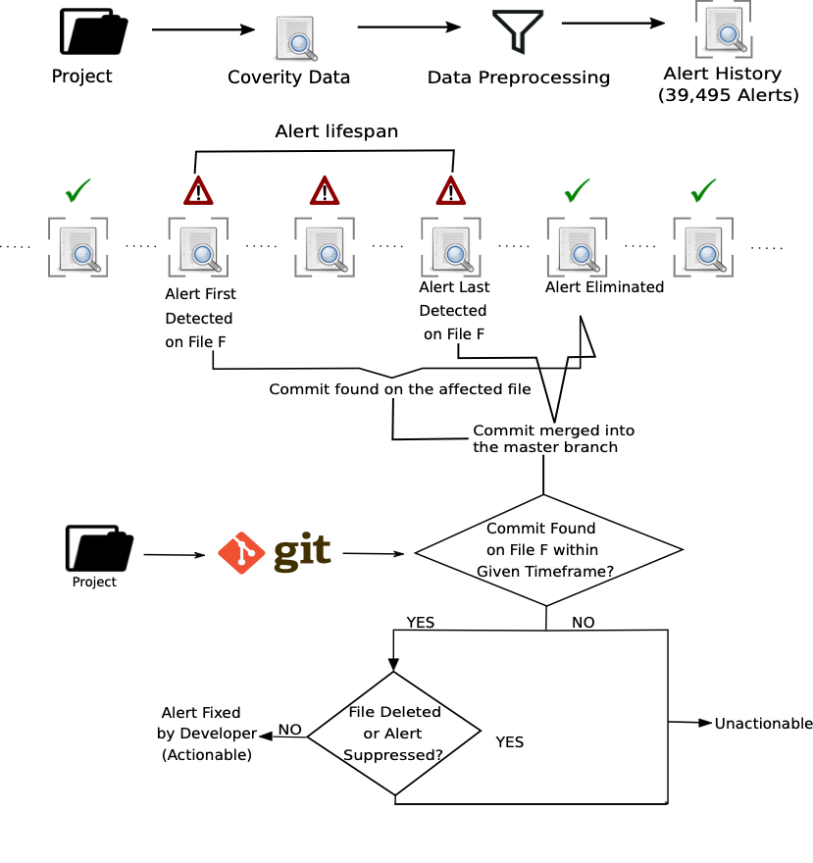
How do we determine actionability and lifespan?

Slide 10
CVE dataset
Pulled CVEs for the projects in Coverity dataset between first and last scan
Collected patch commits for Linux CVEs
Collected available exploit scripts

Slide 11
CWE (Common Weakness Enumeration) classification
Both Coverity alerts and CVEs are mapped with CWE ids
161 distinct CWE ids
Two reviewers independently classified CWE ids as memory vs non-memory
Discussion upon initially disagreed CWE ids to come to a final classification
Kohen’s Kappa agreement rate 0.79
43 (26.7%) were classified as memory-related

Slide 12
Findings:
How frequently do memory-related alerts get identified by a security tool? How do developers respond to these alerts?

Slide 13
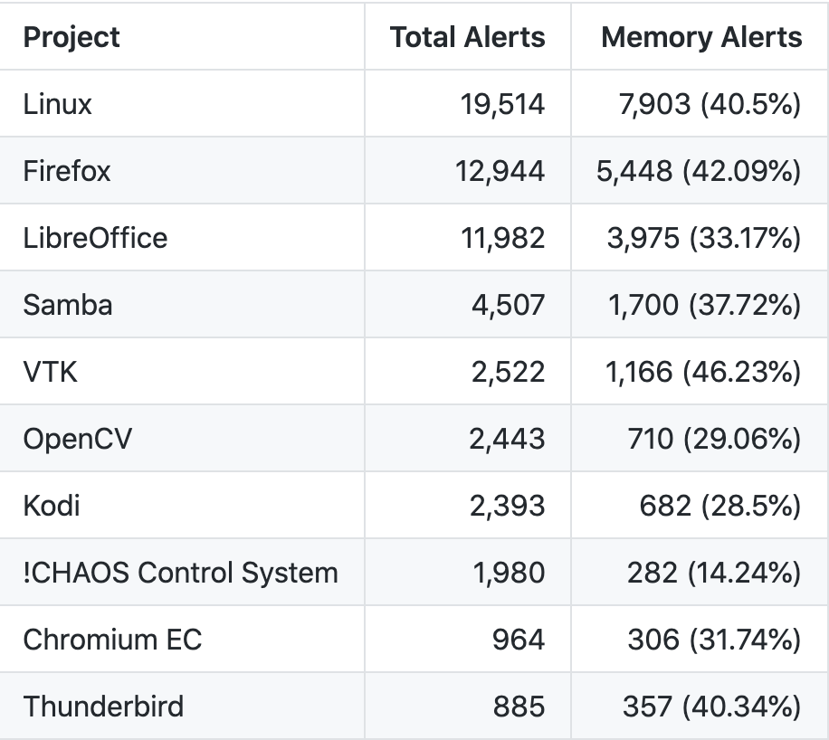
To what extent do memory related alerts appear when C/C++ projects are scanned by Coverity?
Approximately one-third of Coverity alerts were found to be memory related (35.4%)

Slide 14
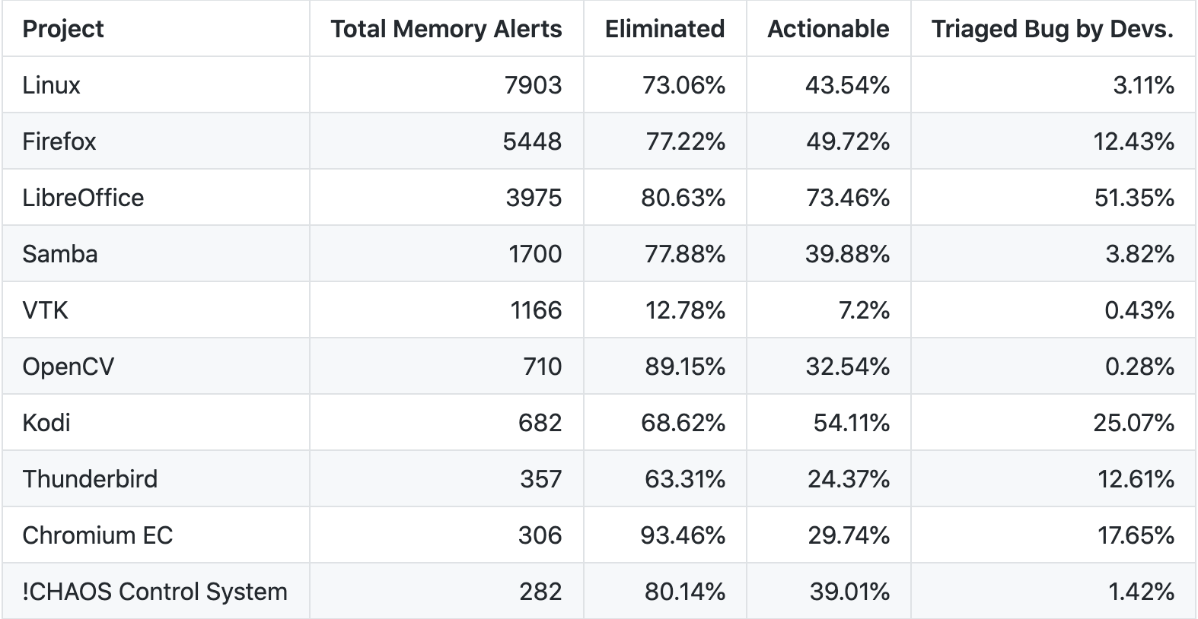
What percent of memory related alerts are actionable (i.e. acted on by developers)?
39.9% of memory alerts were acted on by developers while 12.4% were explicitly marked as bug.

Slide 15
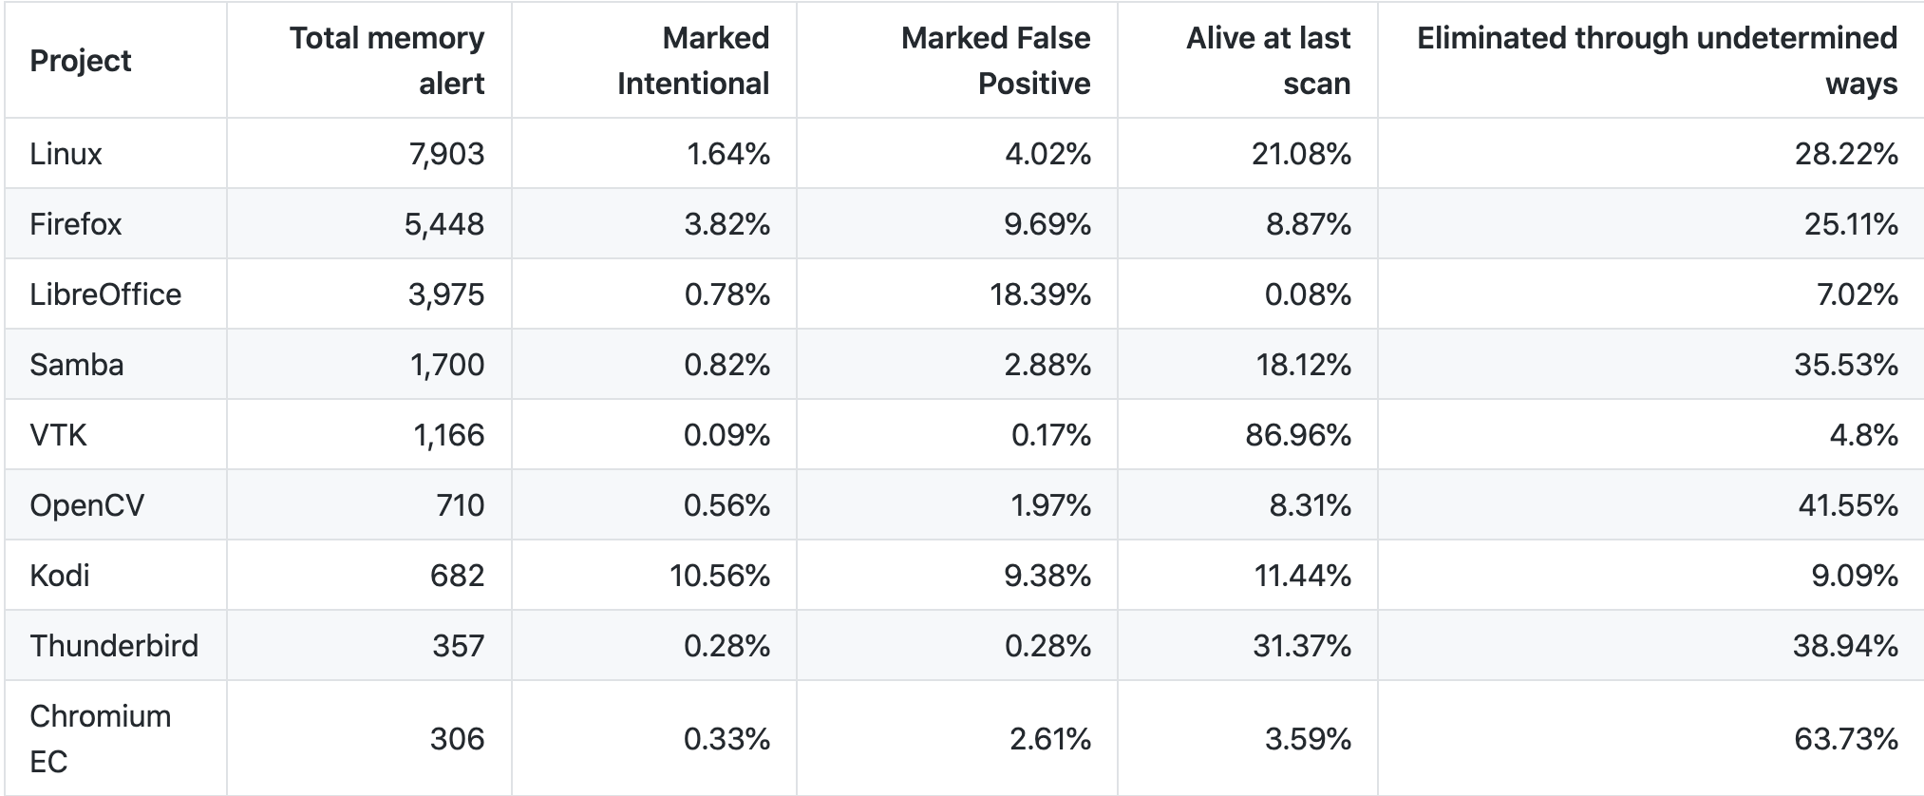
What percent of memory related alerts were marked as false positives/intentional by the developers?
Memory alerts are unlikely to be intentional coding by developers (0.8%)

Slide 16
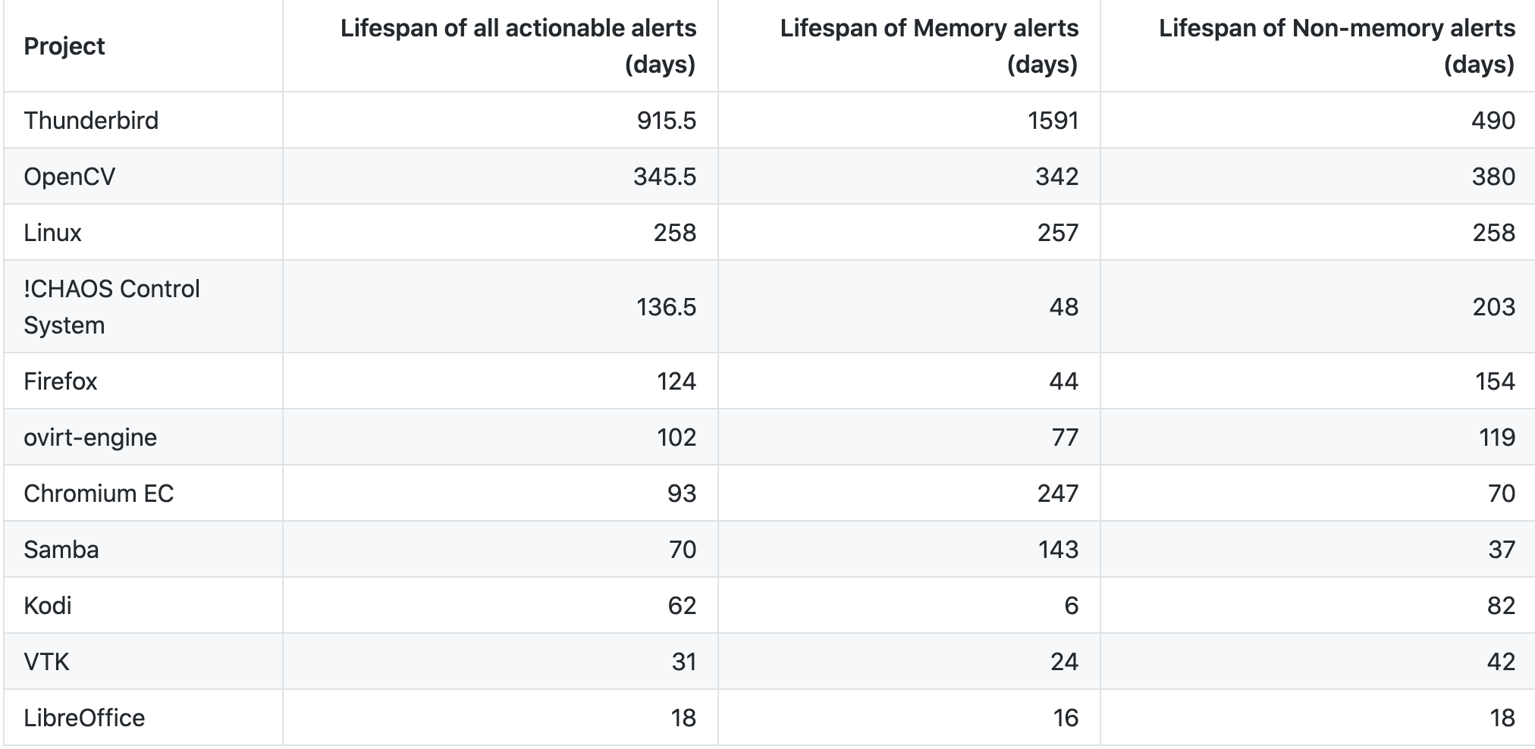
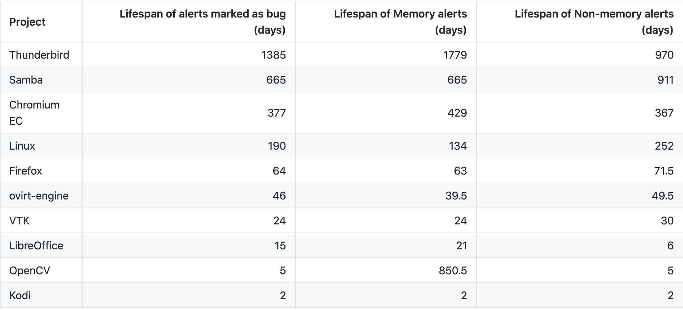
What is the lifespan of memory related alerts on the codebase?
Even memory alerts that are explicitly marked as bug by the project developers, take a median of 98.5 days to get fixed.
Based on how actively developers are monitoring the alerts, some projects take years to fix memory alerts.

Slide 17
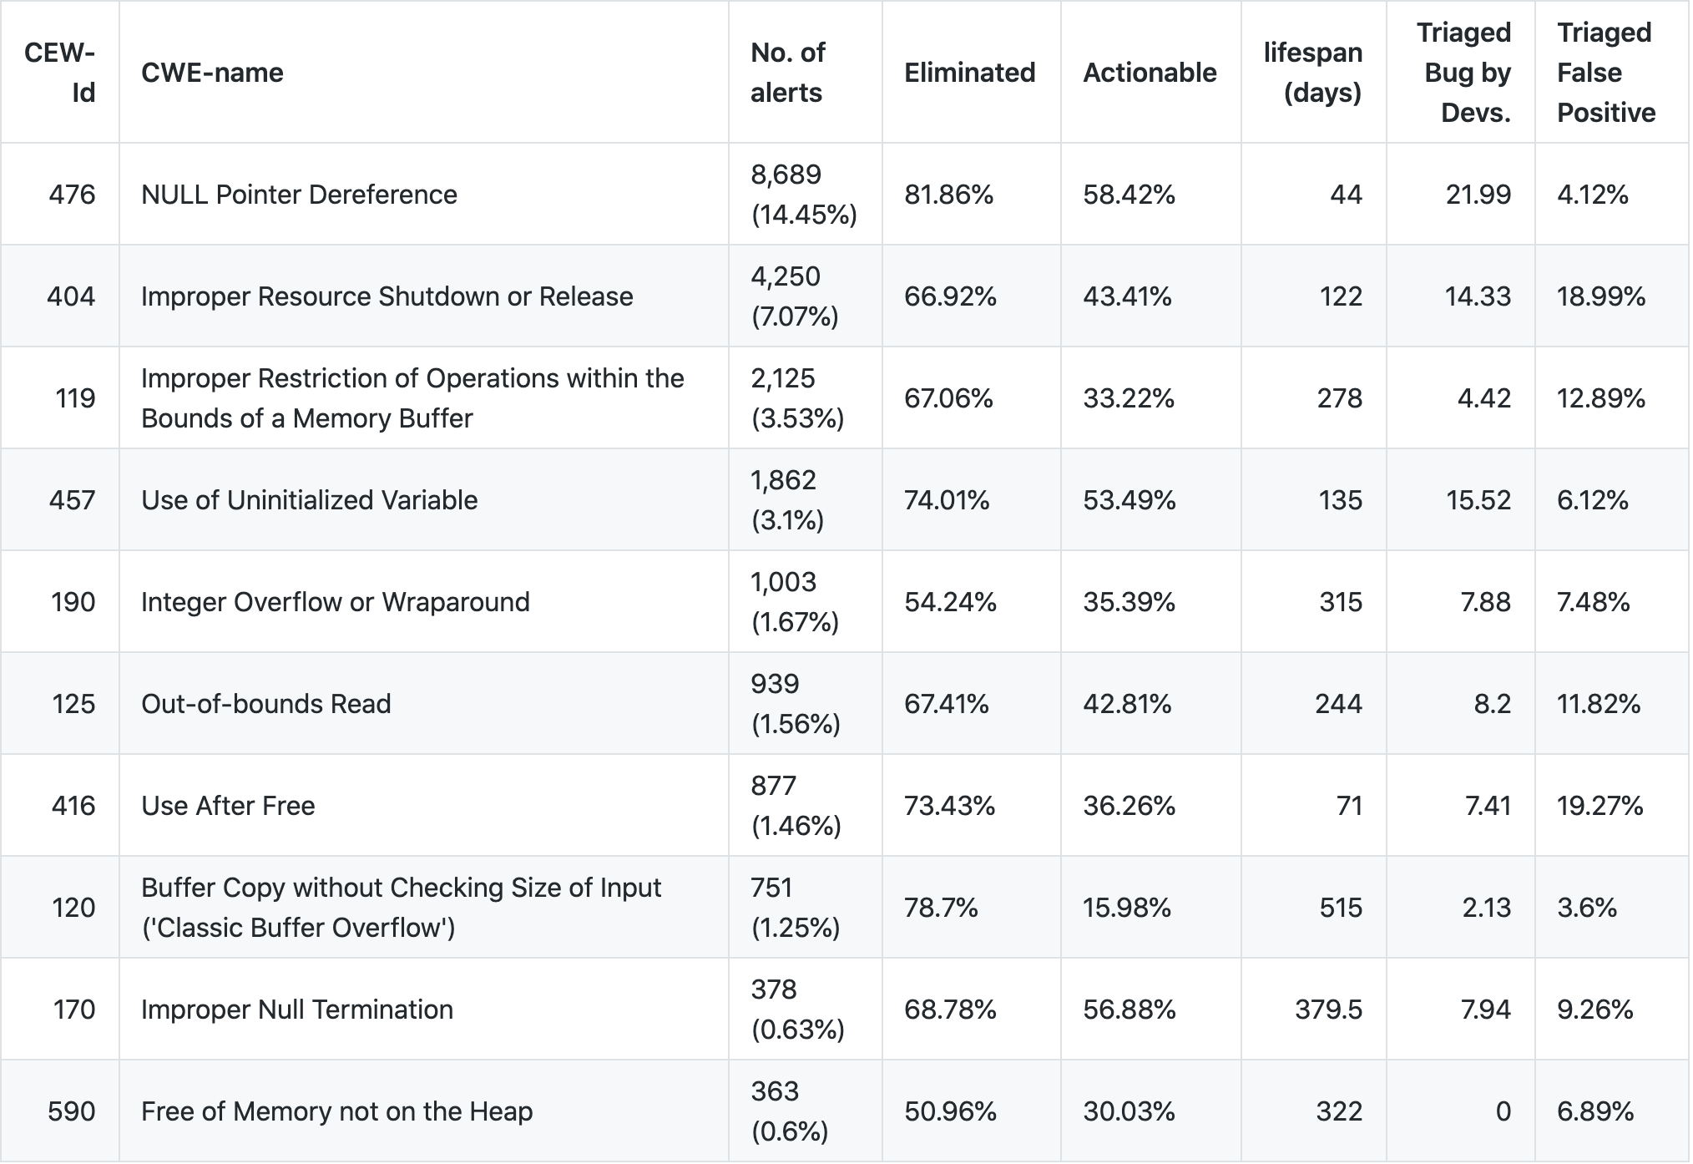
CWE - breakdown

Slide 18
Findings
What portion of CVEs are memory related? How many of these CVEs were identified by the studied security tool when the involved flaws were first introduced in the code?

Slide 19
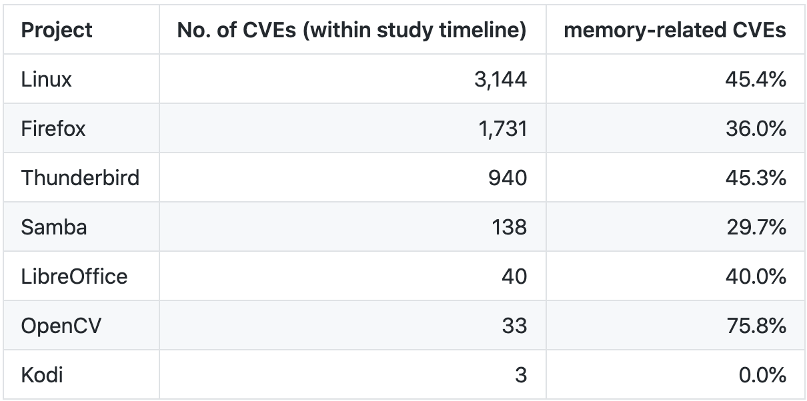
What percent of CVEs are memory related?
40% of the CVEs are memory related.

Slide 20
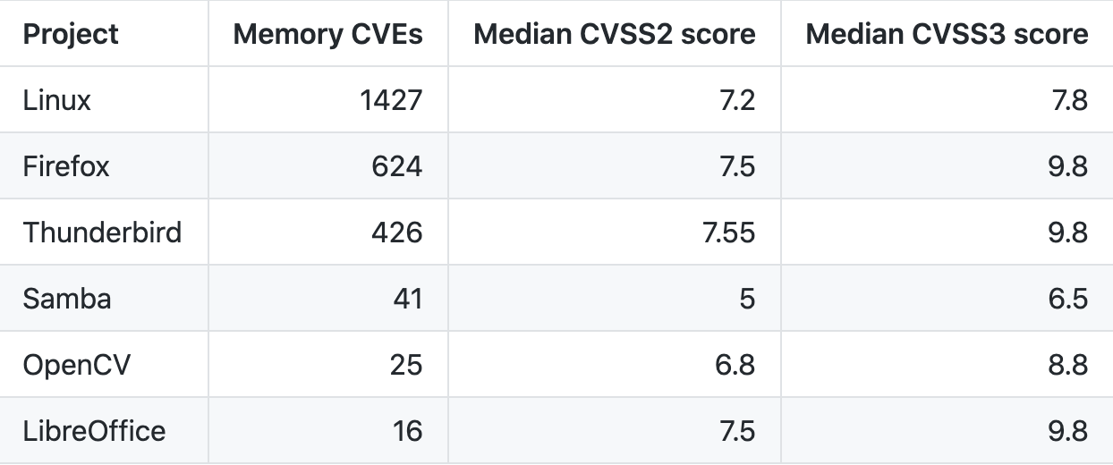
Severity ratings of memory CVEs
Memory CVEs has significantly higher CVSS scores than non-memory errors

Slide 21
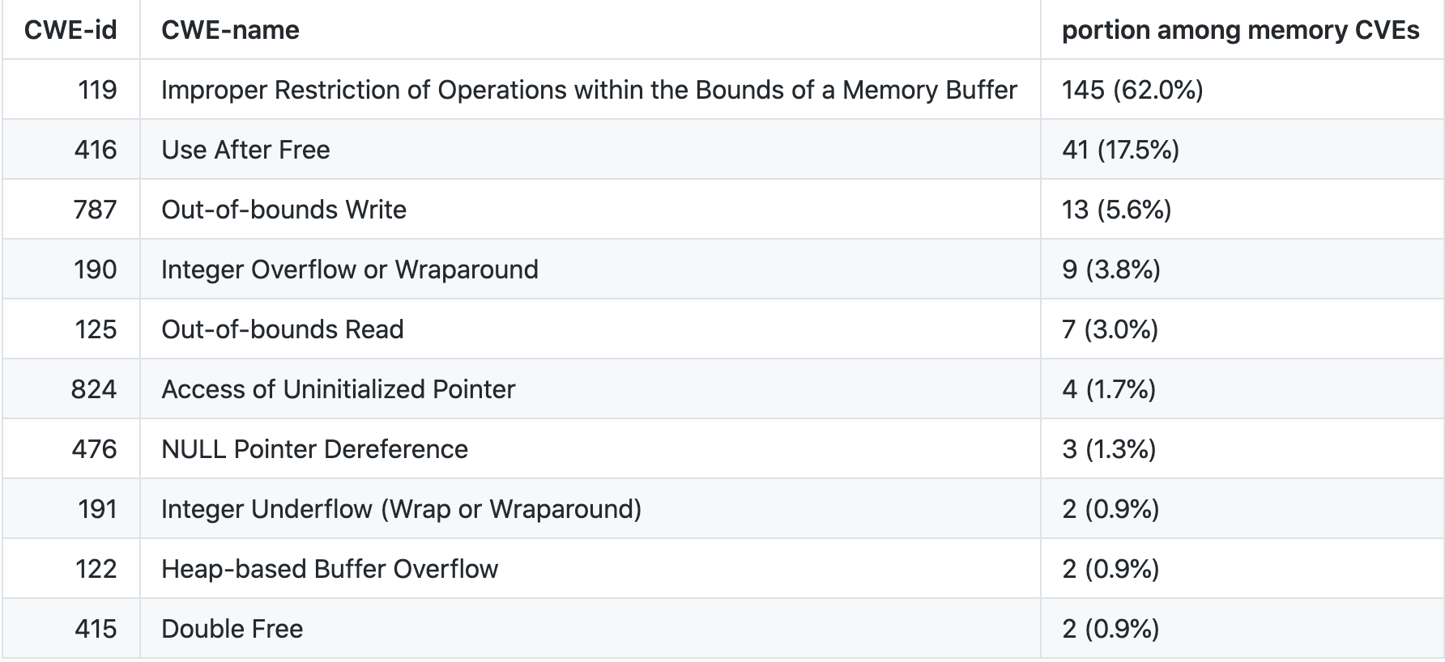
What percent of memory related CVEs have exploit scripts available?
for 396 CVEs among the seven projects, there is an exploit script available out of which 234 (59 %) are memory related.

Slide 22
How many Linux CVEs were identified by Coverity when the vulnerability was first introduced in the code?
For 1,427 memory CVEs in Linux, we could collect patch commit for 592 CVEs.
We analyzed patch commits to get the involved files for a CVE.
If a Coverity had an alert for the CVE, the alert would get fixed when the patch commit is merged.
If there is such Coverity memory alerts on the involved files that get fixed when a CVE get fixed, we assume that Coverity had an alert relevant to the certain CVE.
Only for 15 CVEs (2.5%), we found there was a possible tool alert with a median lifespan of 567 days

Slide 23
Key Takeaways
Memory alerts are frequently detected during security testing
The alerts can take years to get fixed
40% of CVEs are memory related
Their CVSS rating is higher than non-memory CVEs
The likelihood of having a public exploit script is higher
CVEs were mostly undetected during security testing
Only 2.5% Linux CVEs were found during static analysis security testing
A median lifespan of 77 days
Even the CVEs that were found, took a median of 567 days to get fixed

